Slide 1

EXPLORATORY DATA ANALYSIS

Slide 2
About me
My name is Abdul Rauf, and I am currently pursuing my postgraduate degree in M.Sc. Data Science from Aligarh Muslim University. With a strong passion for uncovering insights from data and solving real-world problems, I decided to delve into the field of data science. Recognizing the immense potential of data-driven decision-making across various industries, I chose to specialize in this field to equip myself with the skills and knowledge necessary to make meaningful contributions.
To further enhance my understanding and practical experience in data science, I have embarked on a 3-month internship program at Innomatics Research Labs. This internship provides me with invaluable opportunities to immerse myself in real-world datasets, learn cutting-edge techniques in data analysis and machine learning, and collaborate with industry experts on challenging projects.
Through this internship, I aim to sharpen my analytical abilities, refine my problem-solving skills, and gain hands-on experience with the latest tools and technologies in data science. I am eager to explore diverse domains and tackle complex data challenges, ultimately contributing to innovative solutions that positively impact businesses and society.
Github:-https://github.com/abdulrauf1290
LinkedIn: https://www.linkedin.com/in/abdul-rauf-112612155/

Slide 3
About the AMEO Dataset
The dataset was released by Aspiring Minds from the Aspiring Mind Employment Outcome 2015 (AMEO). The study is primarily limited only to
students with engineering disciplines. The dataset contains the employment outcomes of engineering graduates as dependent variables (Salary, Job Titles, and Job Locations) along with the standardized scores from three different areas – cognitive skills, technical skills and personality skills. The dataset also contains demographic features. The dataset contains around 40 independent variables and 4000 data points. The independent variables are both continuous and categorical in nature. The dataset contains a unique identifier for each candidate. Below mentioned table contains the details for the original dataset.

Slide 4
Summary of the Dataset
ID: Unique identifier for each candidate.
Salary: Annual CTC offered to the candidate in INR (Continuous variable).
DOJ: Date of joining the company.
DOL: Date of leaving the company.
Designation: Designation offered in the job (Categorical variable).
JobCity: Location of the job (city) (Categorical variable).
Gender: Candidate’s gender (Categorical variable).
DOB: Date of birth of the candidate.
10percentage: Overall marks obtained in grade 10 examinations (Continuous variable).
10board: The school board whose curriculum the candidate followed in grade 10 (Categorical variable).
12graduation: Year of graduation - senior year high school.
12percentage: Overall marks obtained in grade 12 examinations (Continuous variable).
12board: The school board whose curriculum the candidate followed in grade 12 (Categorical variable).
CollegeID: Unique ID identifying the college which the candidate attended.
CollegeTier: Tier of the college (Categorical variable).
Degree: Degree obtained/pursued by the candidate (Categorical variable).
Specialization: Specialization pursued by the candidate (Categorical variable).
CollegeGPA: Aggregate GPA at graduation (Continuous variable).
CollegeCityID: Unique ID to identify the city in which the college is located.
CollegeCityTier: The tier of the city in which the college is located (Categorical variable).
CollegeState: Name of the state where the college is located (Categorical variable).
GraduationYear: Year of graduation (Bachelor’s degree).
English, Logical, Quant: Scores in AMCAT sections (Continuous variables).
Domain: Scores in AMCAT’s domain module (Continuous/Standardized variable).
ComputerProgramming, ElectronicsAndSemicon, ComputerScience, MechanicalEngg, ElectricalEngg, TelecomEngg, CivilEngg: Scores in AMCAT’s sections related to specific engineering fields (Continuous variables).
Conscientiousness, Agreeableness, Extraversion, Neuroticism, Openess_to_experience: Scores in sections of AMCAT’s personality test (Continuous/Standardized variables).

Slide 5
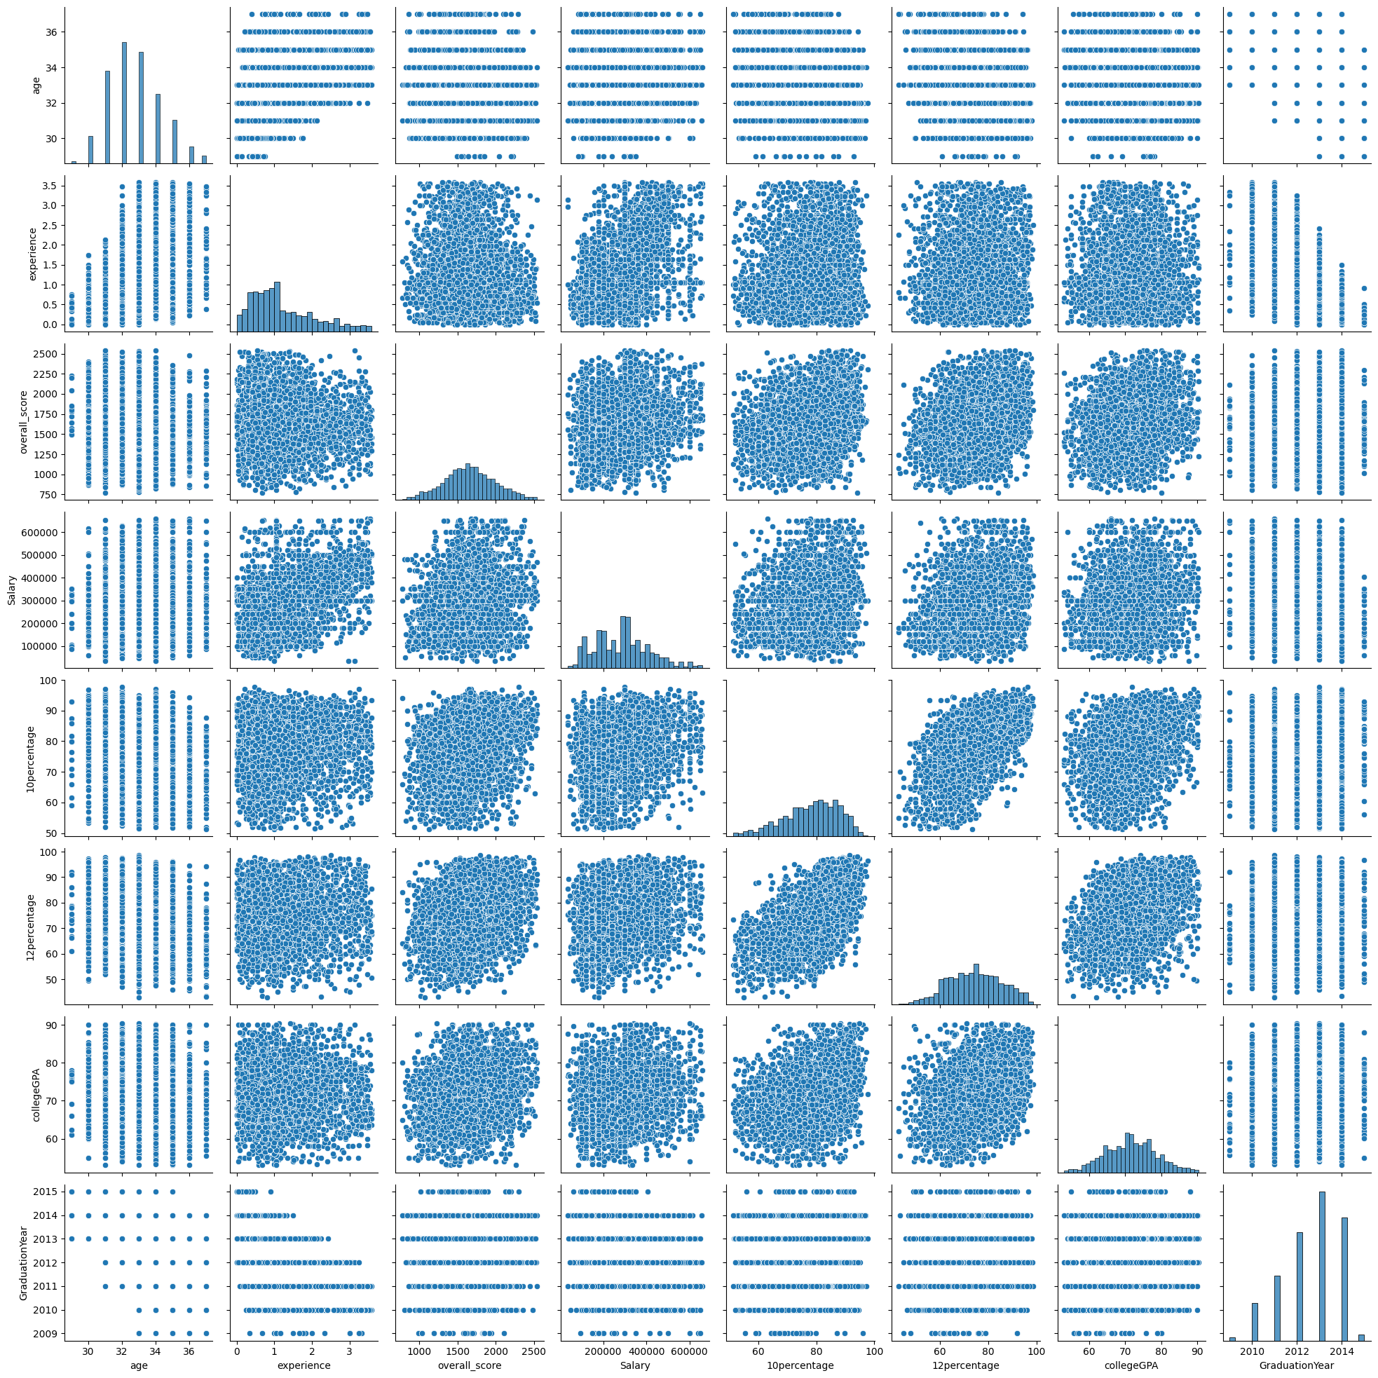
From this pair plot we find out that there is a linear relationsship between the
10th percentage and the 12th percentage and similarly there is a linear relationship
Between CollegeGPA and 12th percentage

Slide 6
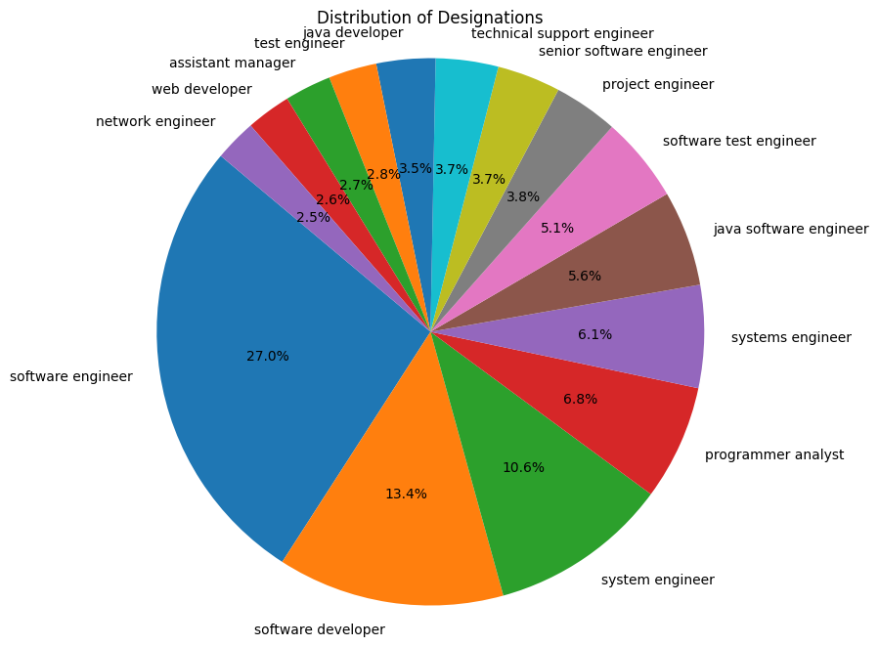
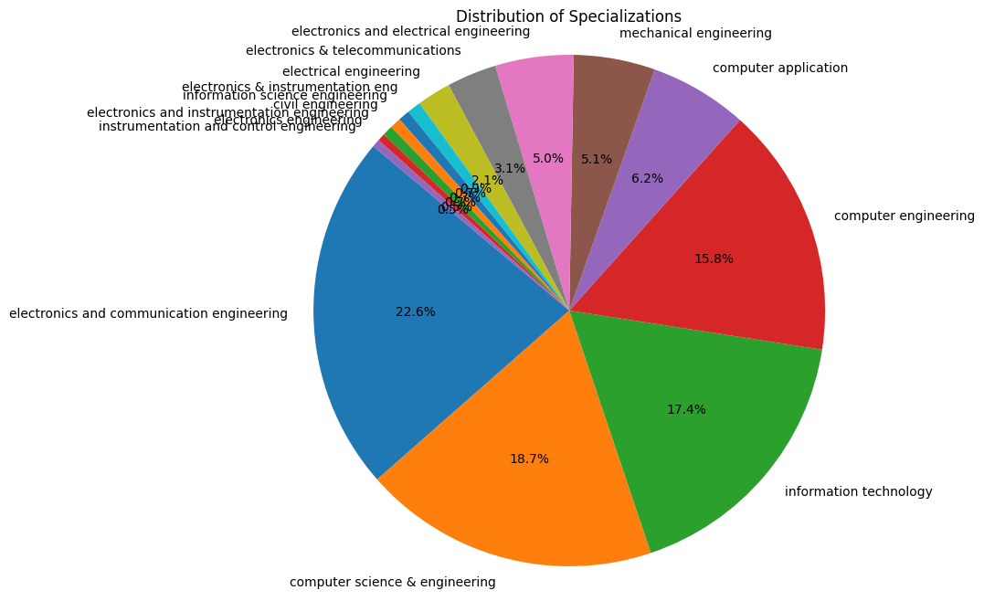
This Pie chart gives us the detail that most of the designation holder are the software engineer and then software developer
This Pie chart gives us the detail that most of the specializations are Electronics and communication engineer then computer science then IT after that computer engineering.They are comprising of almost 74.5% of the total and rest are in only 25.5%

Slide 7
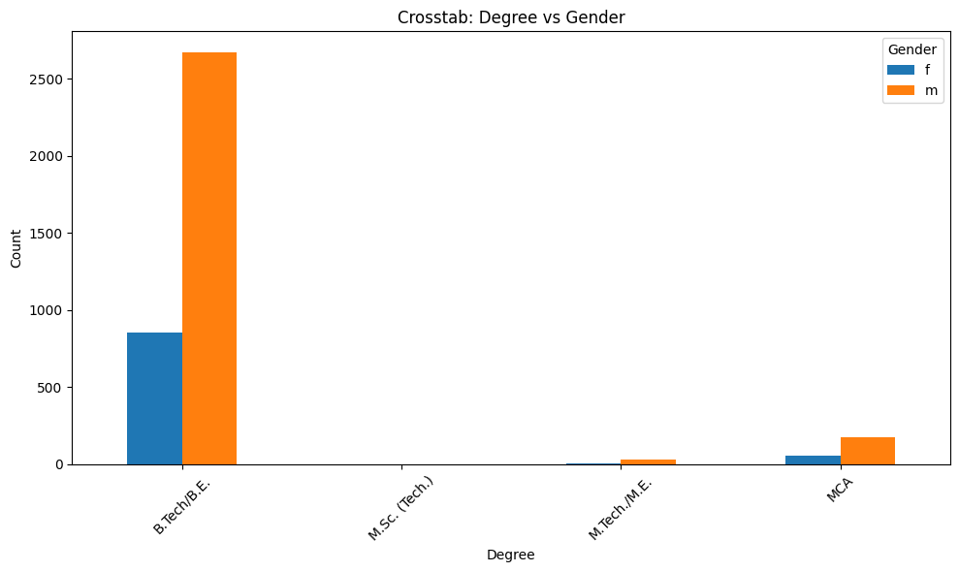
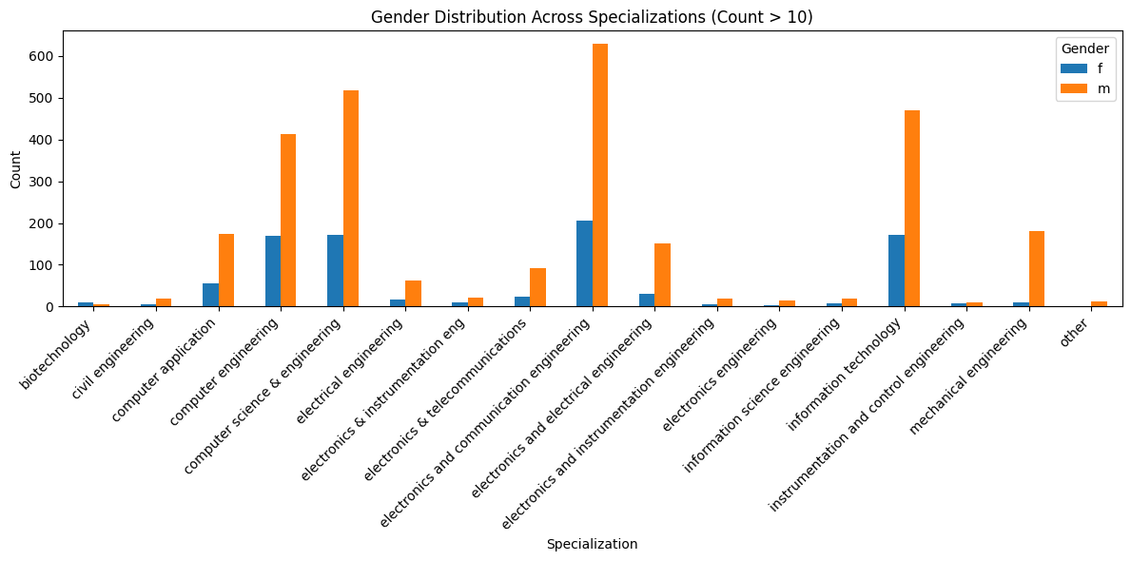
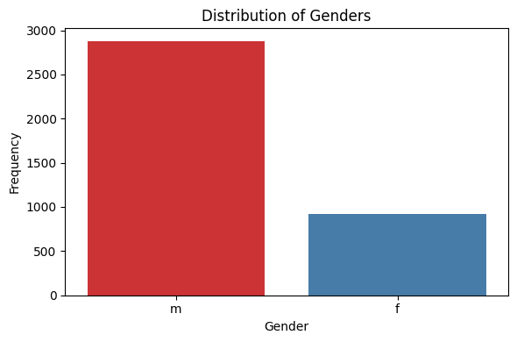
In this slide we can see that mostly girls are from Btech /BE degree and in second plot we found thatin biotechnology females are in more numbers than males

Slide 8
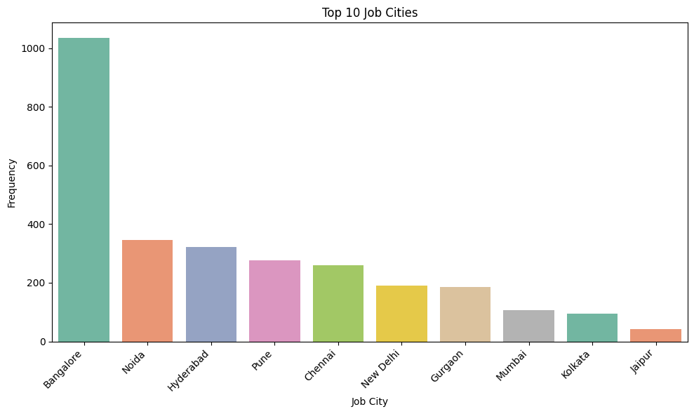
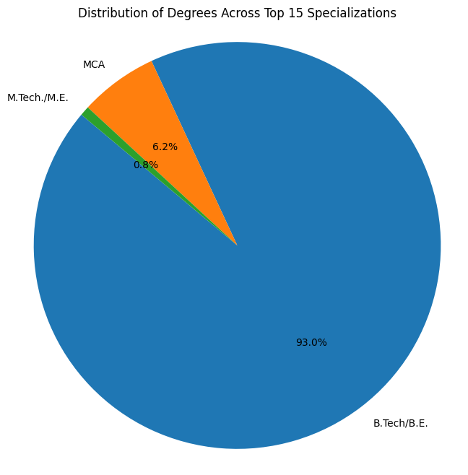
Job wise Bangalore is the hub for job and then Noida Followed by Hydrabad
Specialization wise Btech/BE Degree are having more jobs after that MCA.
Btech/BE are having 93% of the total holding in specialization

Slide 9
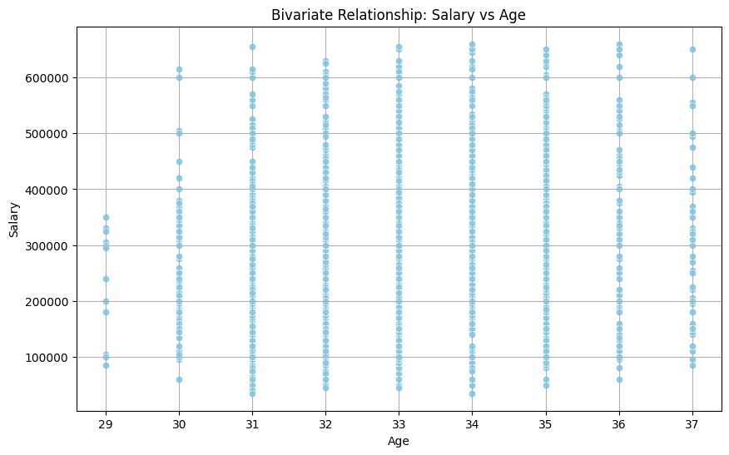
From this we can analyse that most of the people of 34 year of age are getting salary more than the 600000 and the people of age 31 are getting the salary less than 100000.There are less people of 29 year of age and they are getting maximum salary of less than 400000.

Slide 10
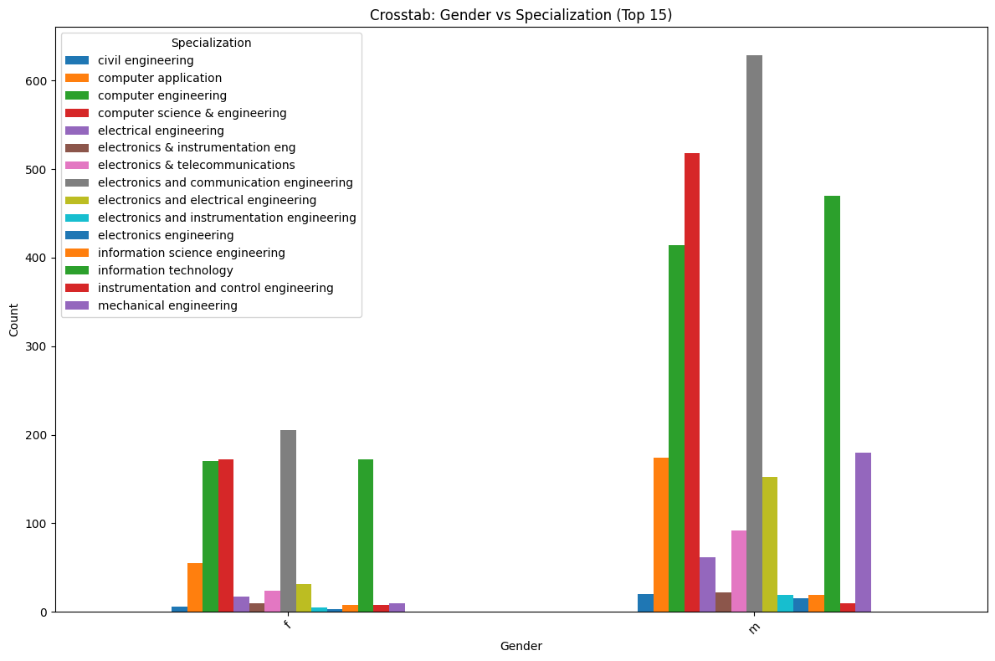
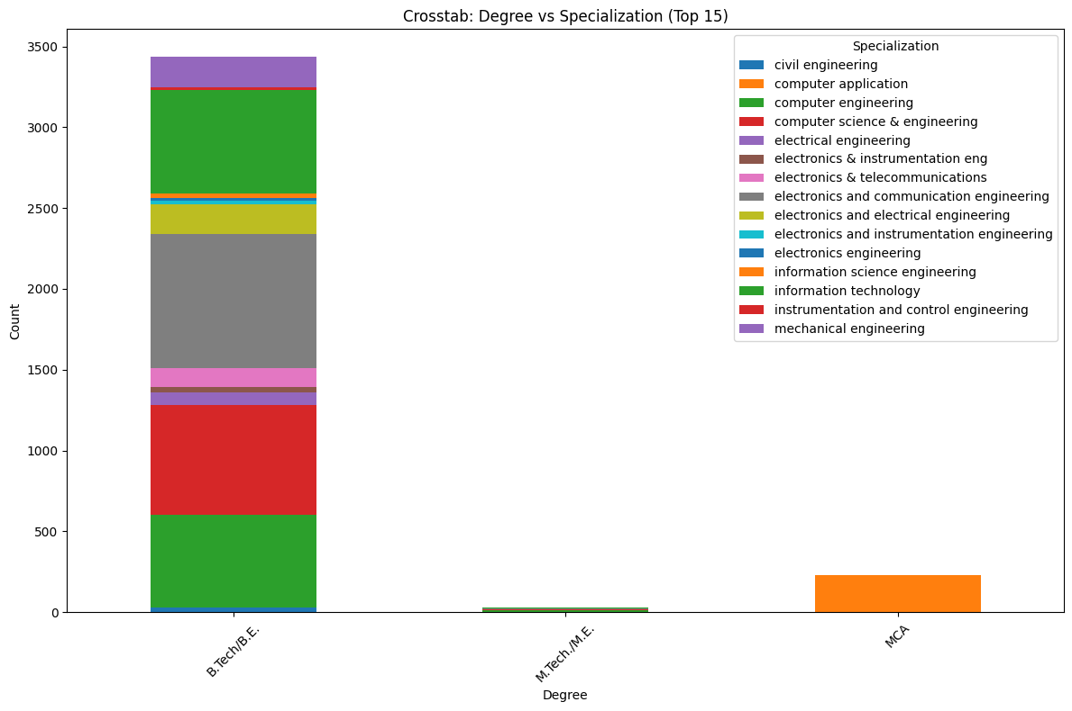
These plots are showing the gender wise specialization . Here in female also electronics and communication engineering are more in count .Computer engineering ,computer science & engineering and IT are around same in number but in male computer & science engineering are more .
MCA students are only in Computer application but Btech /BE are in every specialization.

Slide 11
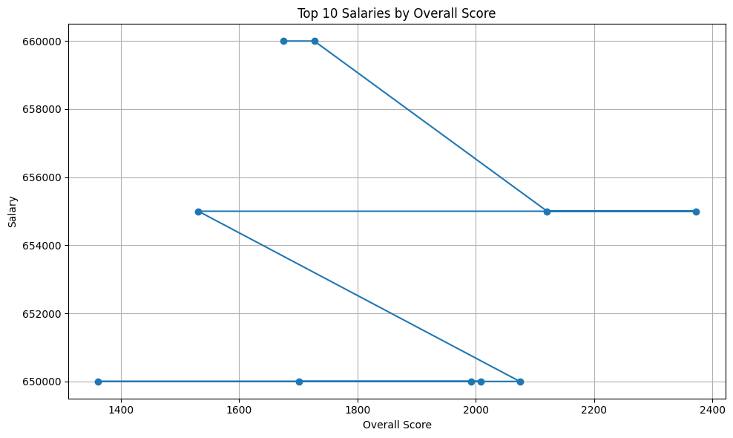
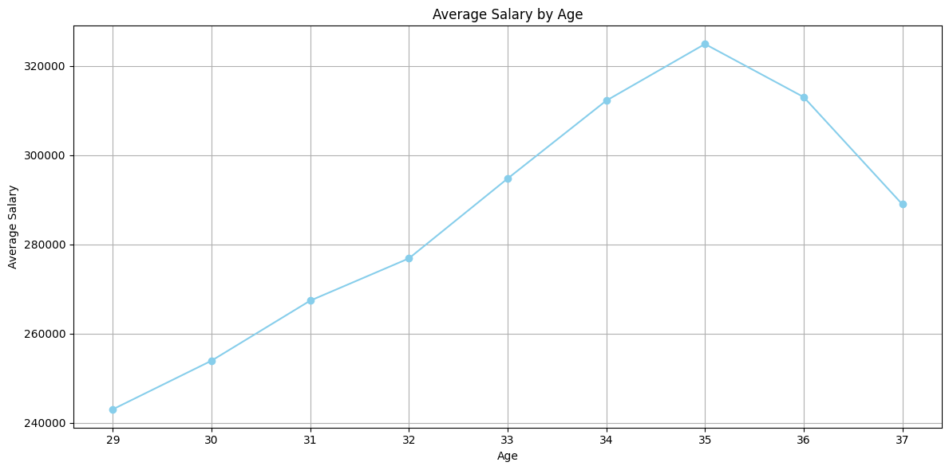
On comparing the overall_score and the Top salaries we came to the conclusion that those who are getting highest score are not getting high pay. Highest pay is 660000.
On comparing age with average salary we acme to the conclusion that 35 year of age having average high salary then the rest and 29 year of age are getting the lowest pay. Average pay of 35 years of age are greater than 320000.

Slide 12
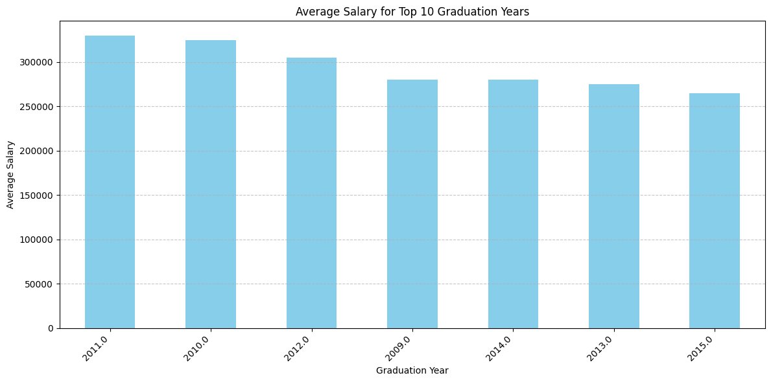
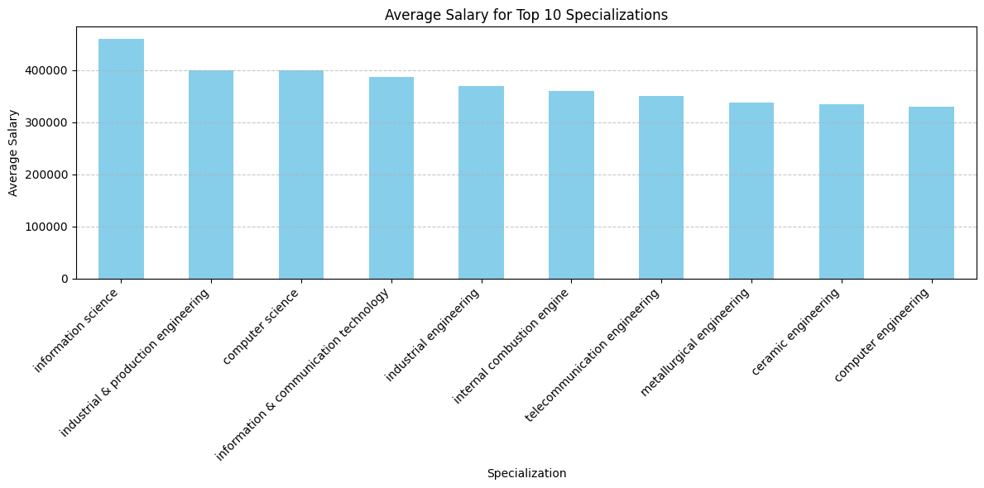
Average salary of graduates that have been pass out in 2011 are getting average salary of more than 300000 and 2010 are also have nearly same average salary.
People having the specialization in information science are getting average salary of more than 400000 and they have highest average salary then other Specialized people

Slide 13
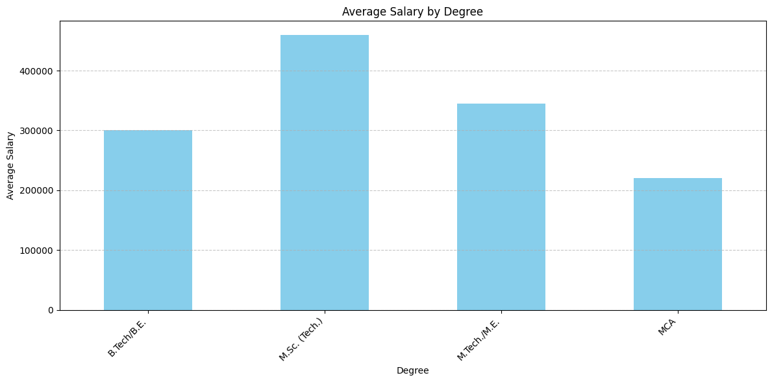
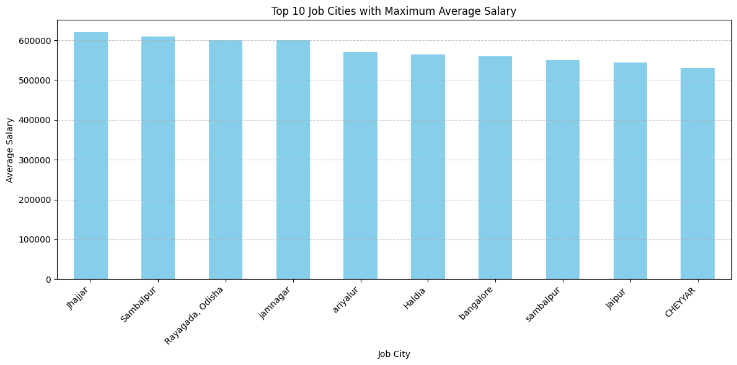
Average salary of Msc (Tech) is greater than 400000 and it highest among all of the other degree holders.
People having job in Jhajjar have average pay of more than 600000 and they are getting the highest average pay among the other job cities.

Slide 14
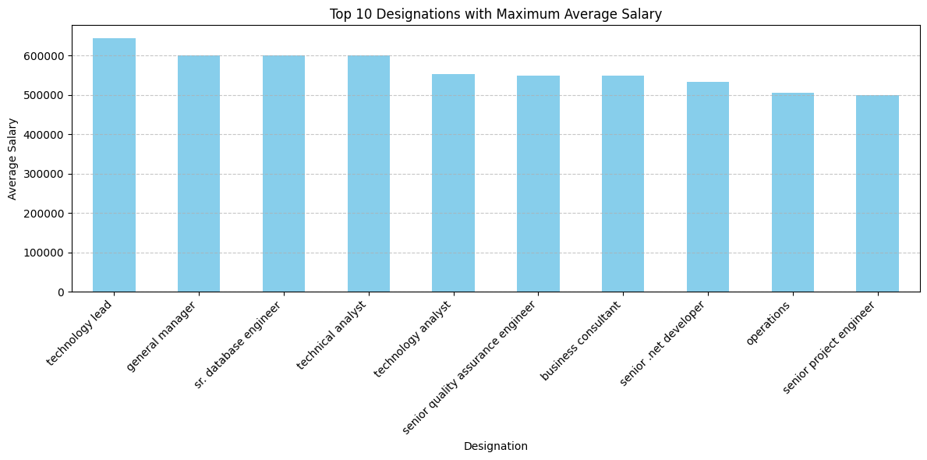
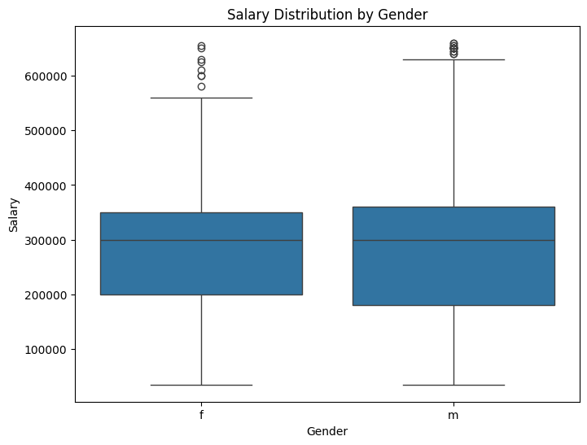
Male and female both are nearly have same average pay but the range of male are higher than that of female
People having the designation of Technology lead are getting average pay of more than 600000

Slide 15

THANK YOU

